Slide 1
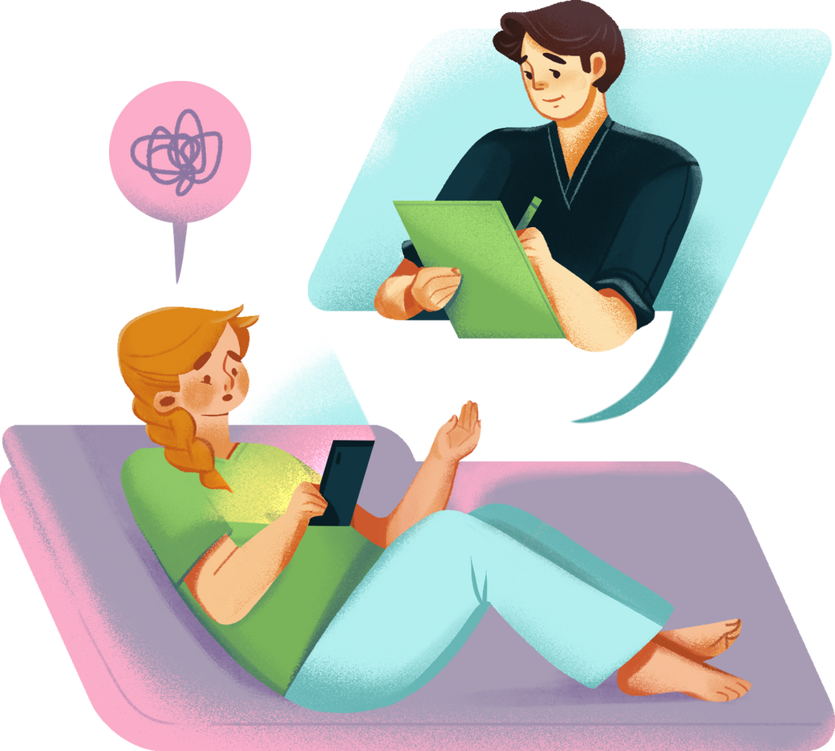
Sahara- A Mental Health Chatbot
APP USER MANUAL
AUTHOR: RAAGA NAMUDURI

Slide 2
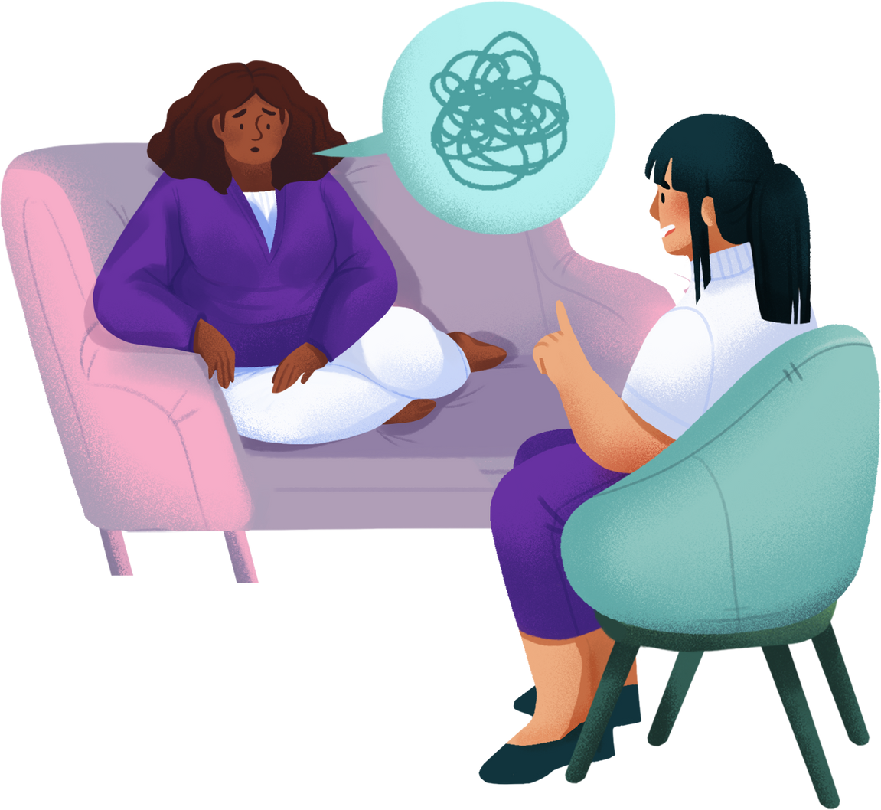
Table of Contents
Acknowledgements
About Me
My Internship Journey with Clevered
About Raaga Mental Health Bot
How to Use the Bot
Features in Detail
Contact Information

Slide 3
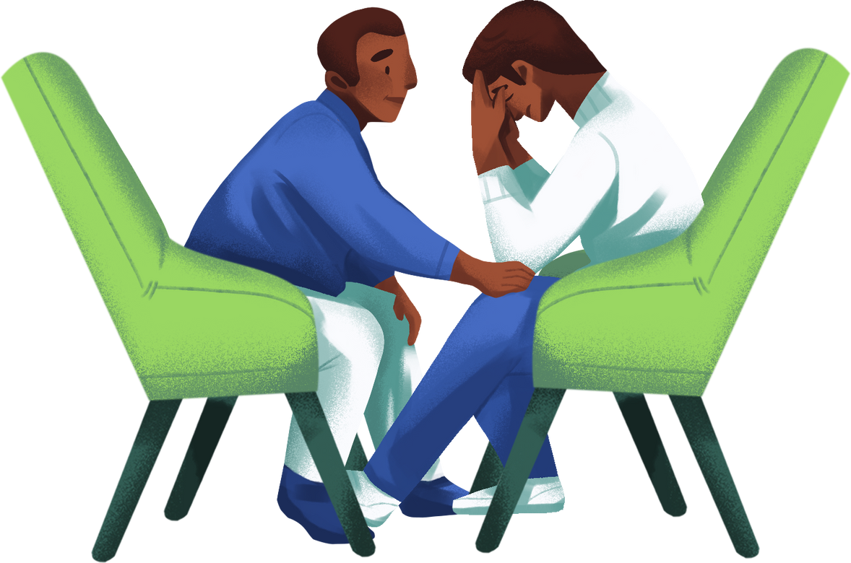
Acknowledgements
I would like to thank my mentor- Mr. Avishek Das, my parents, friends, and Clevered for their constant encouragement and guidance in building this project. Special thanks to Mr. Ken for his support.

Slide 4
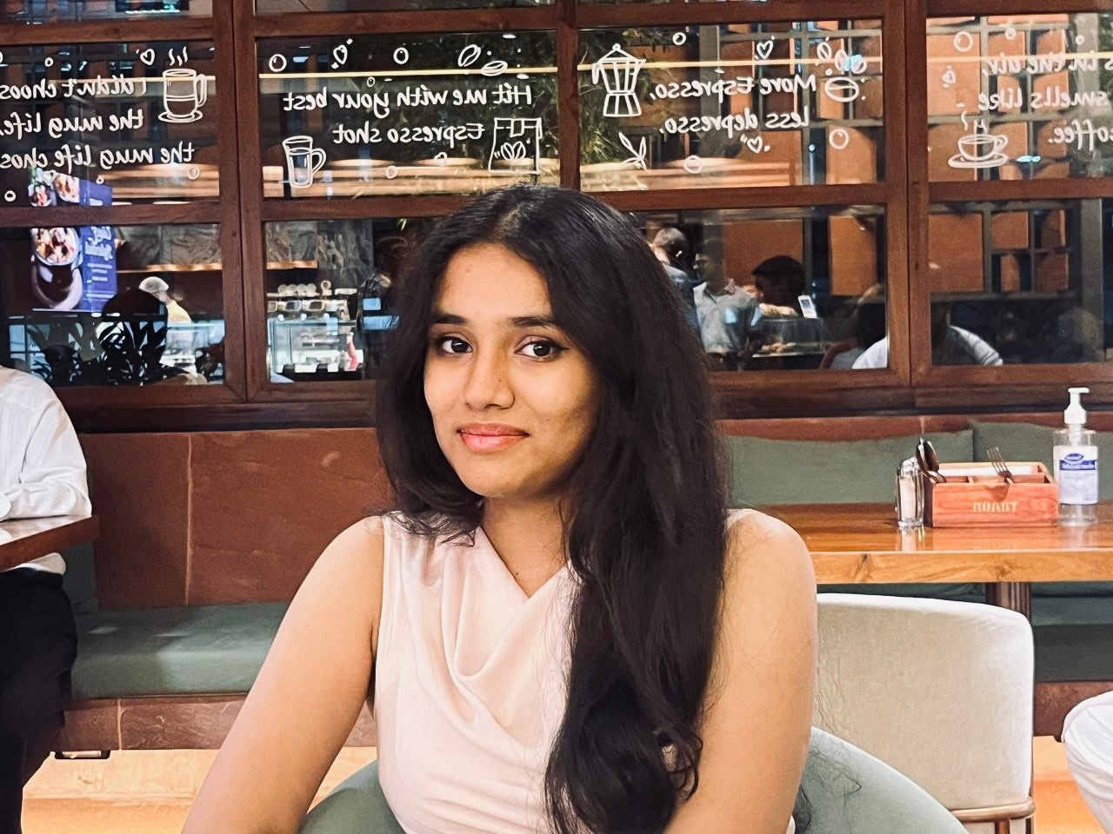
About Me
I’m Raaga, a class 12 student, Delhi Public School Hyderabad.
Passionate about AI — explored human–AI interaction through school curriculum, workshops, and extracurricular projects in community service & entrepreneurship.
As a student, I’ve seen peers struggle with loneliness, stress, and personal challenges without access to therapy.
My own experiences in therapy inspired me to build a safe, anonymous, and supportive chatbot for those who need someone to listen.

Slide 5

About My Internship Journey with Clevered
About My Internship Journey with Clevered
My Clevered internship gave me hands-on experience in building AI applications, especially in Natural Language Processing and chatbot development. I learned to apply Python in real-world problem-solving, follow structured project workflows, and design empathetic AI tools. This journey led to the creation of Sahara, blending technical skills with my passion for mental health support.

Slide 6
About Sahara
Purpose: Provide anonymous, empathetic conversation support to people reluctant to approach a therapist.
Scope: Offers emotional support, shares mental wellness tips, detects signs of crisis, and provides suicide prevention helplines for 3 countries.
Technology: Built using Python, NLP models, and integrated into Google Colab.

Slide 7
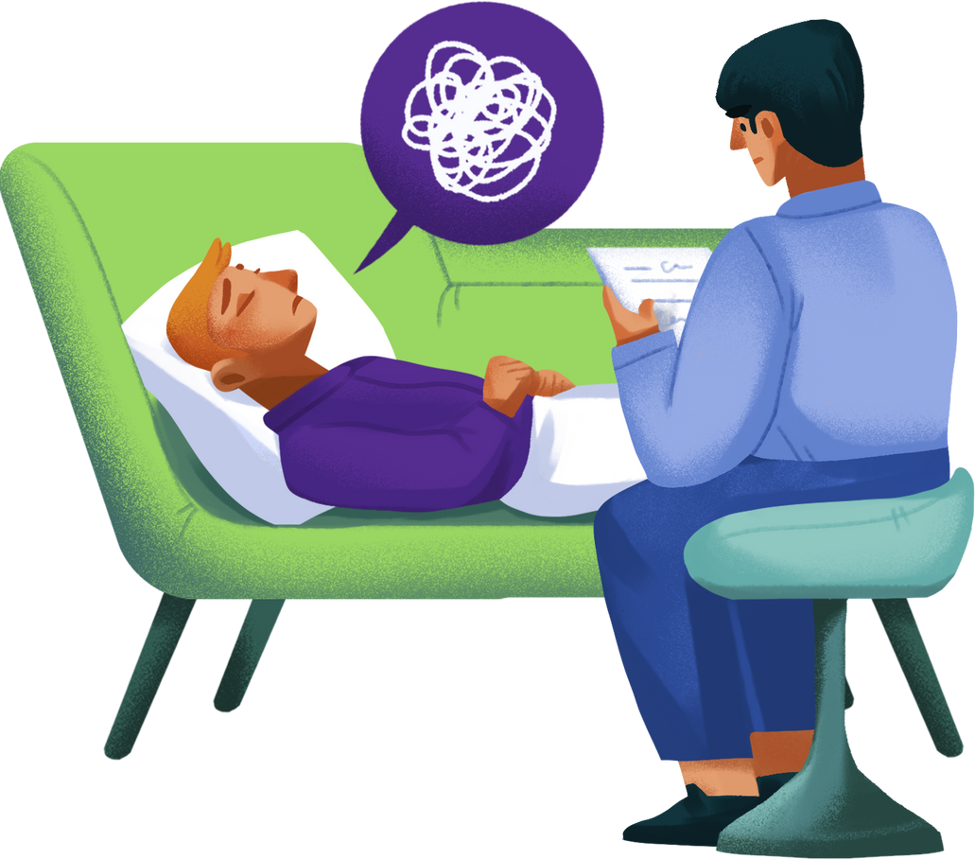
App’s Main Menu(Concept)
Chat with Sahara
Start a private, judgment-free conversation.
Sahara listens to thoughts, emotions, and concerns, responding with empathy and understanding.
Offers gentle guidance, coping strategies, and a safe space to share without fear of stigma.
Crisis Support
Immediate access to verified suicide prevention and mental health helplines.
Covers three countries — India, USA, and UK — to ensure help is localized and relevant.
Presented in an urgent yet compassionate manner during moments of detected emotional crisis.
Self-Care Tips
A curated collection of wellness practices to reduce stress and improve mental health.
Includes mindfulness techniques, breathing exercises, journaling prompts, and daily affirmations.
Encourages healthy coping habits for long-term emotional resilience.

Slide 8
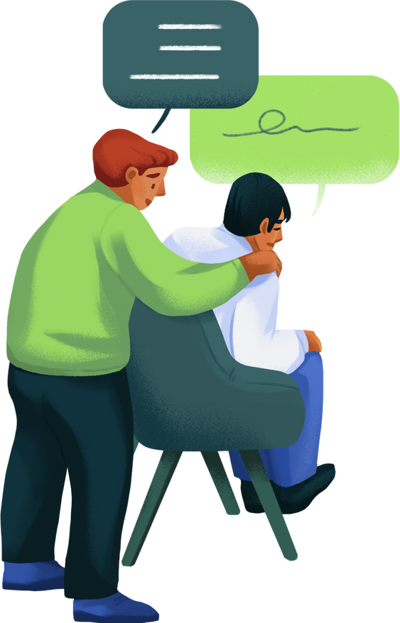
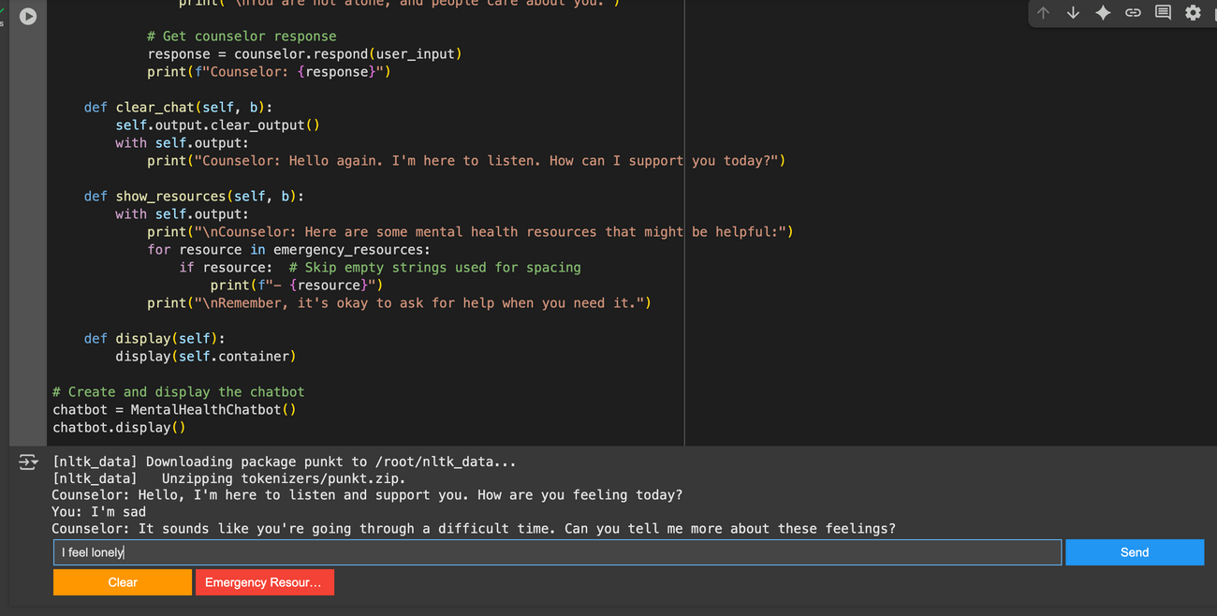
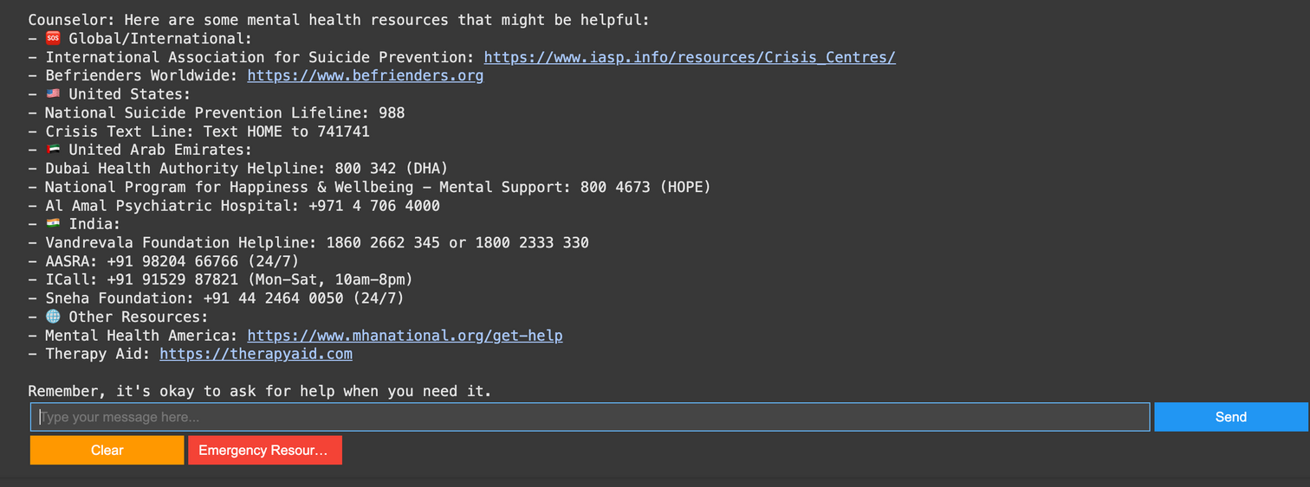
How Do I Use the App? (Step-by-Step)
Option 1 – Chat with Sahara
Open the notebook and run all cells.
Type your message in the input box.
Get supportive, empathetic responses instantly.
Option 2 – Crisis Support
Select"Emergency Resource".
Choose your country from the list.
Get helpline numbers immediately.

Slide 9

Features in Detail
Anonymous Emotional Support – No personal data collected.
24/7 Availability – Accessible anytime via Google Colab.
Crisis Detection – Identifies words or phrases that may indicate suicidal thoughts.
Emergency Helplines – Provides hotline numbers for India, USA, and UK.
Non-Judgmental Interaction – Trained to respond empathetically.
Easy to Use – Minimal setup required.

Slide 10
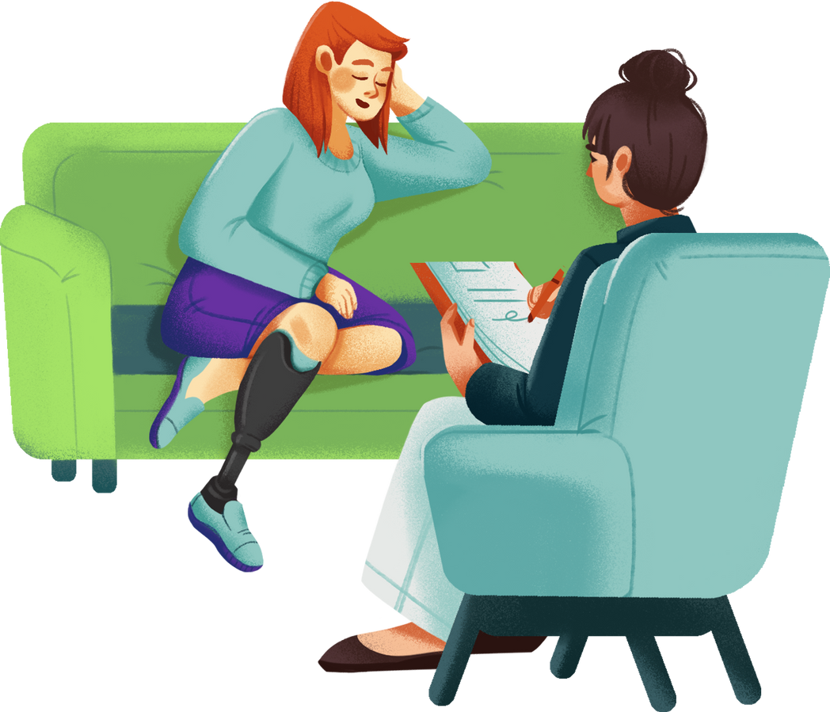
Contact Person
Name: Raaga Namuduri
Email: raaga.niv18@gmail.com
"Your feedback and suggestions are always welcome!"

Slide 11
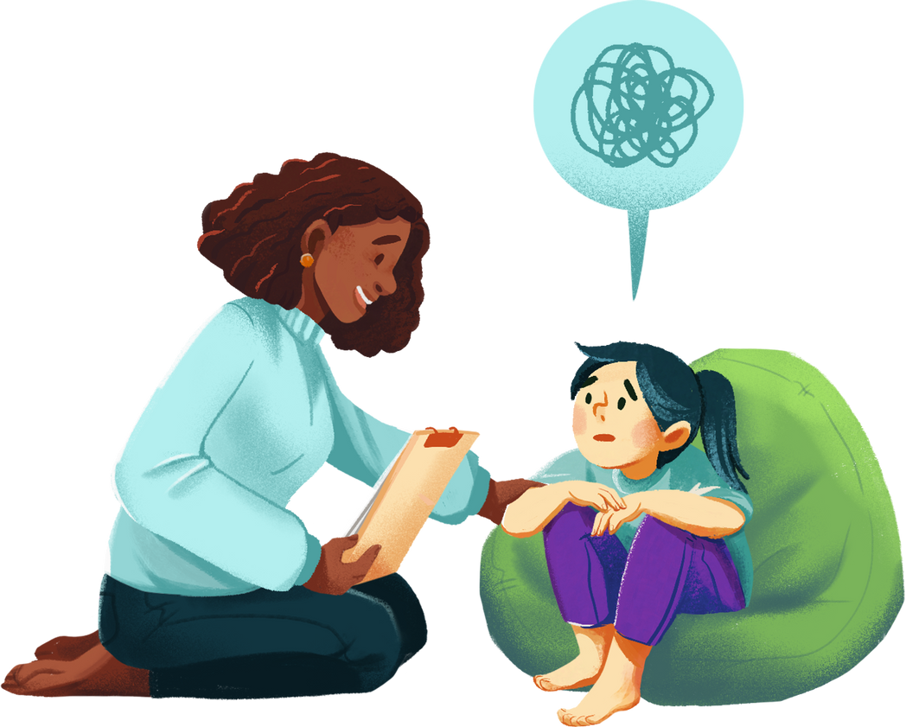
Thank You!

